Slide 1
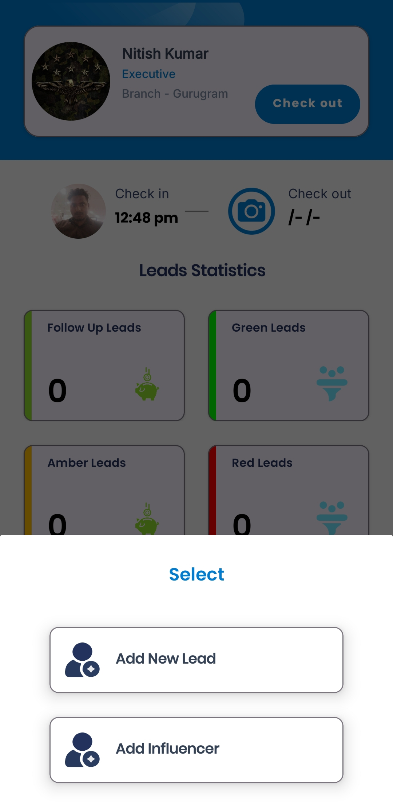
Logging In and Checking In.
Navigating the Dashboard
Adding New Leads.
Green Leads
Amber Leads
Red Leads
Pre Leads
Leads In Process
Query Leads
Leads in LOS
Leads Sanctioned
Add Influencer
Leads Disbursed
  Application Details.
  Co-Borrower Information
  Applicant KYC
  Loan Detail
  Collateral Detail
  CRIF
Total Leads
Influencer Leads
Unassigned Influencer Leads
  Personal Information.
  KYC Information
  Bank Information (Optional)

Slide 2
  Personal Information.
  KYC Information
  Bank Information (Optional)
First Name
Last Name
Phone Number
Email ID
Date of Birth
Password
Branch
PAN Number,
Aadhaar Number
Optionally enter bank information if required.

Slide 3
Add New Lead Flow
Add New Lead
Applicant Details
Details of Applicant
Co-Applicant
We can add Multiple co-Applicant
KYC
Applicants KYC
Co-Applicants KYC
Loan Details
Loan Amount
Tenure etc.
Collateral Details
CRIF

